Slide 1
Test-taking Strategies & Midterm Practice Exam
Hack CPU Logic, Test-taking Strategies, Midterm Practice Exam, Practice Exam Walkthrough and Rubric

Slide 2
Week 7 Announcements
CSE 390B final is Tuesday of finals (12/13), 4:30-6:20pm
Please let the course staff know if you have a conflicting final
Project reminders
First check specification and textbook when you have a question
Please avoid submitting a link on the project documents
Please assign problems to the pages when submitting the project document on Gradescope
Please find a time for the Project 6 mock exam problem and update the spreadsheet (if your group has not already)
Andres’ office hours now on Mondays from 3:30-4:30pm
Location: CSE2 153

Slide 3
Lecture Outline
Hack CPU Logic
Implementation and Operations
Test-taking Strategies
Maximizing Success on Exam Day
Midterm Practice Exam
Mock Exam, Debrief, and Reflection
Practice Exam Solutions and Rubric
Walkthrough of Solutions and Exploring Sample Rubrics

Slide 4
Hack CPU
COMPUTER
ROM
(Instructions)
CPU
RAM
(Data)
instr
data out
0
1
2
010111001110
101100010101
111000101111
...
Instructions
0
1
2
100110010111
100011001111
000000000010
...
Data
addr of next instruction
REGISTERS
data in
CONTROL
INPUT
OUTPUT

Slide 5
Hack CPU Interface Inputs
inM: Value coming from memory
instruction: 16-bit instruction
reset: if 1, reset the program

Slide 6
Hack CPU Interface Outputs
outM: value used to update memory if writeM is 1
writeM: if 1, update value in memory at addressM with outM
addressM: address to read from or write to in memory
pc: address of next instruction to be fetched from memory

Slide 7
Hack CPU Implementation
pc

Slide 8
Hack CPU Implementation
(each "C" symbol represents a control bit)

Slide 9
CPU Operation: Instruction Handling
(each "C" symbol represents a control bit)

Slide 10
CPU Operation: Instruction Handling
@5
0000000000000101
A-instruction

Slide 11
CPU Operation: Instruction Handling
@5
0000000000000101
A-instruction
CPU handling of an A-instruction:
Decodes the instruction into:
op-code
15-bit value
Stores the value in the A-register
Outputs the value (not shown in this diagram)

Slide 12
CPU Operation: Instruction Handling
C-instruction
D=D+1;JMP
1110011111010111

Slide 13
Hack: C-Instructions
Symbolic:
Binary:
dest = comp ; jump
1 1 1 a c1 c2 c3 c4 c5 c6 d1 d2 d3 j1 j2 j3
Family:
C-Instruction
Unused
Comp:
ALU Operation (a bit chooses between A and M)
Dest:
Where to store result
Jump:
Condition for jumping

Slide 14
CPU Operation: Instruction Handling
C-instruction
D=D+1;JMP
1110011111010111
CPU handling of a C-instruction:
Decodes the instruction bits into:
Op-code
ALU control bits
Destination load bits
Jump bits
Routes these bits to their chip-part destinations
The chip-parts (most notably, the ALU) execute the instruction

Slide 15
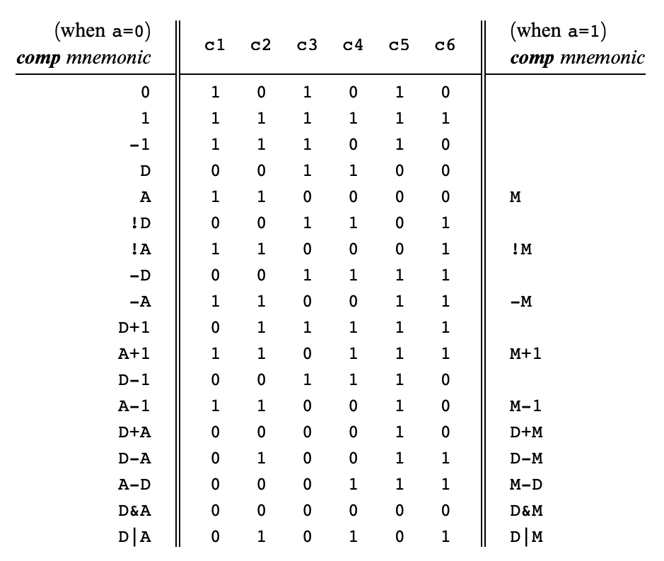
Hack: C-Instructions
Symbolic:
Binary:
dest = comp ; jump
1 1 1 a c1 c2 c3 c4 c5 c6 d1 d2 d3 j1 j2 j3
Comp:
ALU Operation (a bit chooses between A and M)
Chapter 4
Important: just pattern matching text!
Cannot have “1+M”

Slide 16
CPU Operation: Handling C-Instructions
011111
1…01
1110011111010111
1…10
writeM
ALU data inputs:
Input 1: from the D-register
Input 2: from either:
A-register, or
data memory
ALU control inputs:
Control bits (from the instruction)

Slide 17
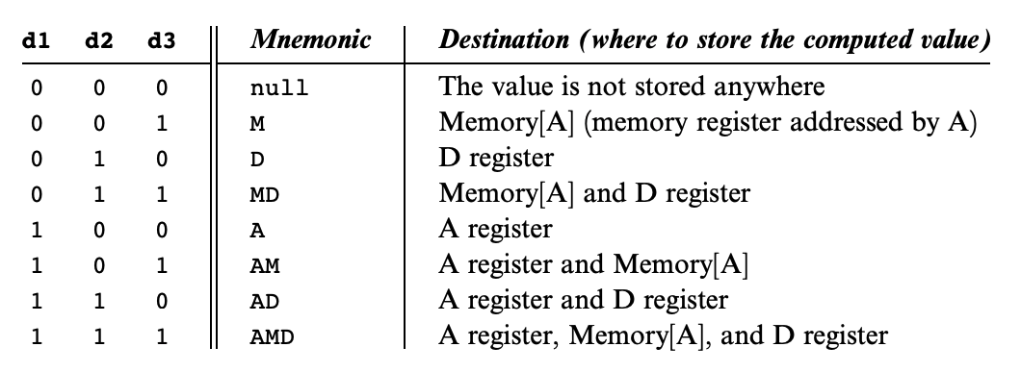
Hack: C-Instructions
Symbolic:
Binary:
dest = comp ; jump
1 1 1 a c1 c2 c3 c4 c5 c6 d1 d2 d3 j1 j2 j3
Dest:
Where to store result
Chapter 4

Slide 18
CPU Operation: Handling C-Instructions
1
011111
0
1…01
0…11
1110011111010111
1…10
writeM
0
ALU data output:
Result of ALU calculation
Fed simultaneously to: D-register, A-register, data memory
Which destination actually commits to the ALU output is determined by the instruction’s destination bits

Slide 19
CPU Operation: Handling C-Instructions
011111
1…01
0…11
1110011111010111
1…10
writeM
ALU control outputs:
Is the output negative?
Is the output zero?

Slide 20
CPU Operation: Control
pc

Slide 21
CPU Operation: Control

Slide 22
CPU Operation: Control
16
load
1
pc
Address of next instruction
PC operation (abstraction)
Outputs the address of the next instruction:
Restart: PC = 0
No jump: PC++
Go to: PC = A
Conditional go to: if (condition) PC = A
else PC ++
16

Slide 23
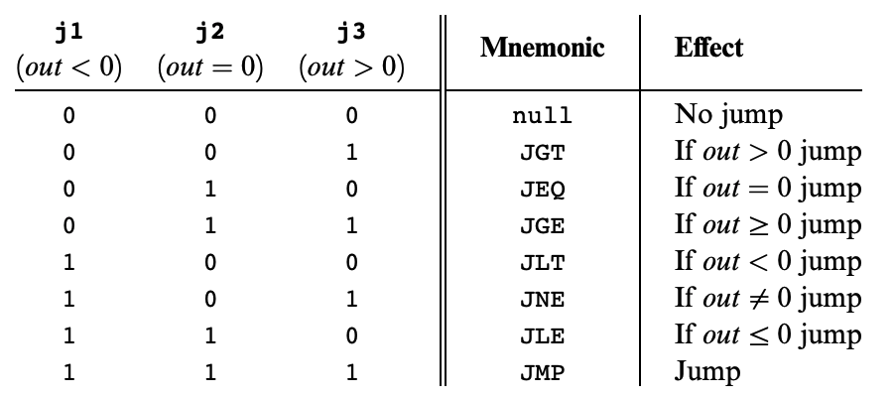
Hack: C-Instructions
Symbolic:
Binary:
dest = comp ; jump
1 1 1 a c1 c2 c3 c4 c5 c6 d1 d2 d3 j1 j2 j3
Jump:
Condition for jumping
Chapter 4

Slide 24
CPU Operation: Control
111 a c c c c c c d d d j j j
16
load
1
pc
Address of next instruction
16
PC operation (implementation)
if (reset==1) PC = 0
else
// In the course of handling the current instruction:
load = f (jump bits, ALU control outputs)
if (load == 1) PC = A // jump
else PC++ // next instruction

Slide 25
Hack CPU Implementation: That’s It!

Slide 26
Lecture Outline
Hack CPU Logic
Implementation and Operations
Test-taking Strategies
Maximizing Success on Exam Day
Midterm Practice Exam
Mock Exam, Debrief, and Reflection
Practice Exam Solutions and Rubric
Walkthrough of Solutions and Exploring Sample Rubrics

Slide 27
Test-taking Strategies Discussion
What are some test-taking strategies you have previously utilized in taking your exams?
Were those strategies you tried effective or not? Why?
How might you try a new test-taking strategy on the CSE 390B midterm or any other upcoming exam?

Slide 28
Test-taking Strategies
Survey the entire exam before beginning
Helps plan how much time to allocate for each problem
Read exam directions and question statements carefully
Use highlights, underlines, circles on important details
Answer the questions you feel the most confident in first
If stuck on a problem, make a mark on the problem and revisit the question later

Slide 29
Test-taking Strategies
Prioritize how you will answer questions
Do this based on confidence level for each type of question or how long you think each will take
Rely on a methodological approach for each question
Helps make taking the test feel more systematic
If stuck on a question, demonstrate what you know
Many exams reward partial credit
If time allows, double check your answers
Catches any small mistakes that may have been made earlier

Slide 30
Lecture Outline
Hack CPU Logic
Implementation and Operations
Test-taking Strategies
Maximizing Success on Exam Day
Midterm Practice Exam
Mock Exam, Debrief, and Reflection
Practice Exam Solutions and Rubric
Walkthrough of Solutions and Exploring Sample Rubrics

Slide 31
Midterm Practice Exam
The exam is closed-note, closed-book
You may only use the midterm reference sheet
Questions are not necessarily in order of difficulty
You will have 25 minutes to complete the mock exam
We will give you a 5-minute warning
Remember to relax and take deep breaths

Slide 32
Mock Exam Debrief & Reflection
What did you learn about yourself through this process? About your test-taking practices?
What are two test-taking strategies that you would like to engage with in your next exam? Why?
What is one thing that can help you relax and calm down before or during your exam?

Slide 33
Lecture Outline
Hack CPU Logic
Implementation and Operations
Test-taking Strategies
Maximizing Success on Exam Day
Midterm Practice Exam
Mock Exam, Debrief, and Reflection
Practice Exam Solutions and Rubric
Walkthrough of Solutions and Exploring Sample Rubrics

Slide 34
Question 1: Circuit Design
Part a: Truth Table
A_{t} | B_{t} | A_{t+1} | B_{t+1}
1 | 1 | 1 | 0
1 | 0 | 0 | 1
0 | 1 | 0 | 0
0 | 0 | 1 | 1
11 → 10 → 01 → 00 → 11

Slide 35
Question 1: Circuit Design
Part a: Truth Table
A_{t} | B_{t} | A_{t+1} | B_{t+1}
1 | 1 | 1 | 0
1 | 0 | 0 | 1
0 | 1 | 0 | 0
0 | 0 | 1 | 1
11 → 10 → 01 → 00 → 11

Slide 36
Question 1: Circuit Design
Part a: Truth Table
A_{t} | B_{t} | A_{t+1} | B_{t+1}
1 | 1 | 1 | 0
1 | 0 | 0 | 1
0 | 1 | 0 | 0
0 | 0 | 1 | 1
A_{t+1} = (A_{t} & B_{t})
A_{t+1} = (~A_{t} & ~B_{t})
Part b: Boolean Expressions

Slide 37
Question 1: Circuit Design
Part a: Truth Table
A_{t} | B_{t} | A_{t+1} | B_{t+1}
1 | 1 | 1 | 0
1 | 0 | 0 | 1
0 | 1 | 0 | 0
0 | 0 | 1 | 1
A_{t+1} = (A_{t} & B_{t})
A_{t+1} = (~A_{t} & ~B_{t})
Part b: Boolean Expressions
A_{t+1} = (A_{t} & B_{t}) | (~A_{t} & ~B_{t})

Slide 38
Question 1: Circuit Design
Part a: Truth Table
A_{t} | B_{t} | A_{t+1} | B_{t+1}
1 | 1 | 1 | 0
1 | 0 | 0 | 1
0 | 1 | 0 | 0
0 | 0 | 1 | 1
A_{t+1} = (A_{t} & B_{t})
B_{t+1} = (A_{t} & ~B_{t})
A_{t+1} = (~A_{t} & ~B_{t})
B_{t+1} = (~A_{t} & ~B_{t})
Part b: Boolean Expressions
A_{t+1} = (A_{t} & B_{t}) | (~A_{t} & ~B_{t})
B_{t+1} = (A_{t} & ~B_{t}) | (~A_{t} & ~B_{t})
= ~B_{t} & (A_{t} | ~ A_{t}) [Factor out ~B_{t}]
= ~B_{t} [A_{t} | ~ A_{t} = 1]

Slide 39
Question 1: Circuit Design
Part a: Truth Table
Part c: Drawing the Circuit
A_{t} | B_{t} | A_{t+1} | B_{t+1}
1 | 1 | 1 | 0
1 | 0 | 0 | 1
0 | 1 | 0 | 0
0 | 0 | 1 | 1
Part b: Boolean Expressions
A_{t+1} = (A_{t} & B_{t}) | (~A_{t} & ~B_{t})
B_{t+1} = (A_{t} & ~B_{t}) | (~A_{t} & ~B_{t})
= ~B_{t} & (A_{t} | ~ A_{t}) [Factor out ~B_{t}]
= ~B_{t} [A_{t} | ~ A_{t} = 1]

Slide 40
Question 1: Circuit Design Sample Rubric
Category | Points | Criteria
Truth Table | 4 points | 1 point for each row in the truth table that is correct
Boolean Expressions | 6 points | 4 points for correct expression for A_{t+1} 2 points if truth table is wrong but expression matches truth table 2 points for correct expression for B_{t+1} 1 point if truth table is wrong but expression matches truth table
Circuit Diagram | 5 points | 3 points for having circuits that match the Boolean expressions in part b 2 points for fully correct diagram
Total | 15 points

Slide 41
Question 2: Math Puzzle
Dana needs 300 pickets for her colorful picket fence. She wants equal amounts of each of her 4 selected colors. She already has 32 red, 26 green, 9 yellow, and no blue. If the pickets cost 25 cents and you get 20% off if you purchase 50 or more of the same color, and 30% off if you purchase 60 or more of one color, how much does Dana need to spend? List your answer to two decimal places. You may use a calculator application on your computer to solve this problem.

Slide 42
Question 2: Math Puzzle
Dana needs 300 pickets for her colorful picket fence. She wants equal amounts of each of her 4 selected colors. She already has 32 red, 26 green, 9 yellow, and no blue. If the pickets cost 25 cents and you get 20% off if you purchase 50 or more of the same color, and 30% off if you purchase 60 or more of one color, how much does Dana need to spend? List your answer to two decimal places. You may use a calculator application on your computer to solve this problem.
Solution
$75 − 32 = 43 red$
$75 − 26 = 49 green$
$75 − 9 = 66 yellow$
$75 − 0 = 75 blue$
$$43 × 0.25 + 49 × 0.25 + 0.7 × 66 × 0.25 + 0.7 × 75 × 0.25$$
$= \$47.675$
$= \$47.68$
(Rounding down is also acceptable)

Slide 43
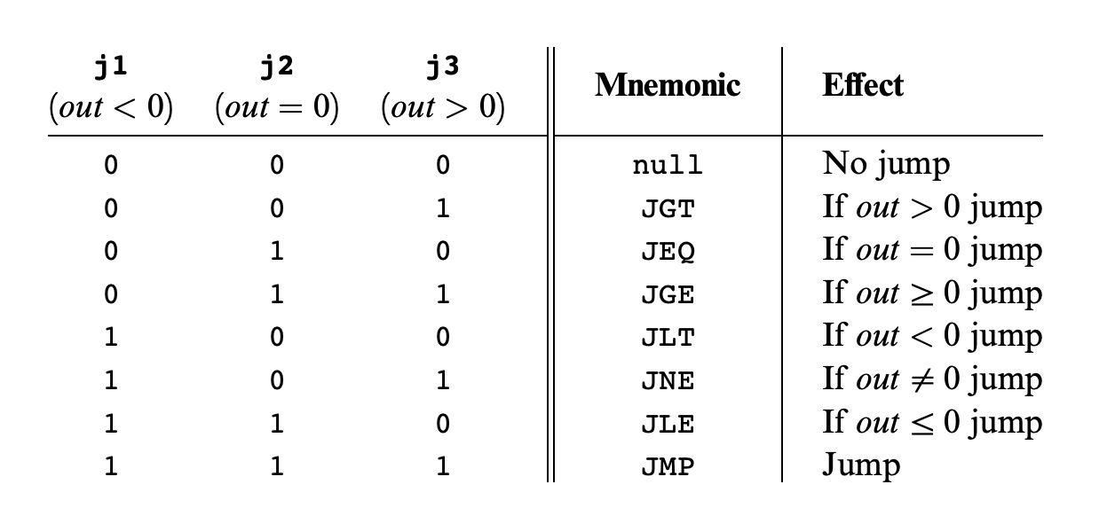
Question 3: Hack Assembly Programming
Write a Hack assembly program that stores -1, 0, or 1 in R1 based on the sign of R0. To be more specific, your program should store a -1 in R1 if R0 is negative, a 0 in R1 if R0 is 0, and a 1 in R1 if R0 is positive.

Slide 44
Question 3: Hack Assembly Programming
Write a Hack assembly program that stores -1, 0, or 1 in R1 based on the sign of R0. To be more specific, your program should store a -1 in R1 if R0 is negative, a 0 in R1 if R0 is 0, and a 1 in R1 if R0 is positive.
Equivalent pseudocode:
if (R0 < 0){
R1 = -1;
} else if (R0 > 0){
R1 = 1;
} else { //R0 == 0
R1 = 0;
}

Slide 45
Question 3: Hack Assembly Programming
One solution:
@R0
D = M
@NEGATIVE
D; JLT
@POSITIVE
D; JGT
// R0 == 0 case
@R1
M = 0
@END
0; JMP
(NEGATIVE)
// R0 < 0 case
@R1
M = -1
@END
0; JMP
(POSITIVE)
// R0 > 0 case
@R1
M = 1
(END)
@END
0; JMP
Write a Hack assembly program that stores -1, 0, or 1 in R1 based on the sign of R0. To be more specific, your program should store a -1 in R1 if R0 is negative, a 0 in R1 if R0 is 0, and a 1 in R1 if R0 is positive.
Equivalent pseudocode:
if (R0 < 0){
R1 = -1;
} else if (R0 > 0){
R1 = 1;
} else { //R0 == 0
R1 = 0;
}

Slide 46
Question 3: Hack Assembly Sample Rubric
Category | Points | Criteria
Has Infinite End Loop | 1 point | 1 point if program has an Infinite End Loop
Conditional Checks | 4 points | 2 points for having at least two checks for cases. Almost all solutions will need a check for 2 of the three cases (negative, zero, positive). 2 points for correctly matching jump condition to cases (e.g. jump to negative case when negative, etc.)
Assigns Correct R1 Value | 3 points | One point for each case: negative: R1 = -1 zero: R1 = 0 positive: R = 1
Fully Correct Implementation | 2 points | Covers any little mistakes that may result in an incorrect implementation (e.g., forgetting to jump to the end when a case is done)
Total | 10 points

Slide 47
Question 4: Metacognitive Skills
Name two metacognitive skills that we have covered in CSE 390B thus far.

Slide 48
Post-Lecture 12 Reminders
CSE 390B midterm this Thursday (11/10) during lecture at 2:30pm
Project 6: Mock Exam Problem & Building a Computer due next Thursday (11/17) at 11:59pm
Preston has office hours after class in CSE2 153
Feel free to post your questions on the Ed board as well

